Slide 1


Slide 2


Slide 3

WELCOME
Ben Dearman – Assistant Dean of Masters Programs
bdearman@unt.edu
Natalie Bernard – Academic Counselor
Natalie.Bernard@unt.edu
DeAnna Taylor – Academic Counselor
Deanna.taylor@unt.edu
Lauren Burnaugh – Sr. Administrative Coordinator
Lauren.Burnaugh@unt.edu

Slide 4
Todays Presentation
Student Email & Important Resources
Your Degree
Registration & Payments
Background Courses
Degree Plan & Advising
Scholarships & Awards
Probation & Suspension Policy
Graduation
Other Campus Resources

Slide 5

Student Email
If you have not already, please set up and check your Eagle Connect official UNT email regularly, http://eagleconnect.unt.edu
Keep email and mailing addresses updated
Exchange contact information with your colleagues today and on the first class day

Slide 6
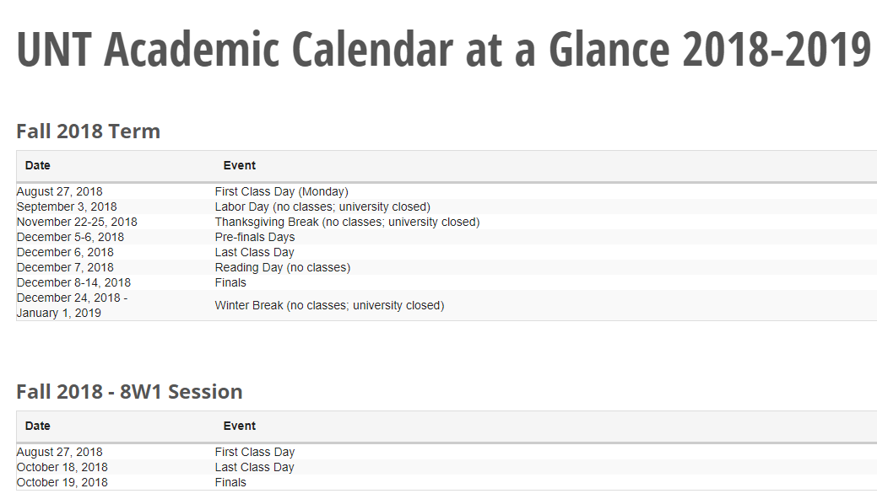
Important Resources
2018-2019 UNT Academic Calendar

Slide 7
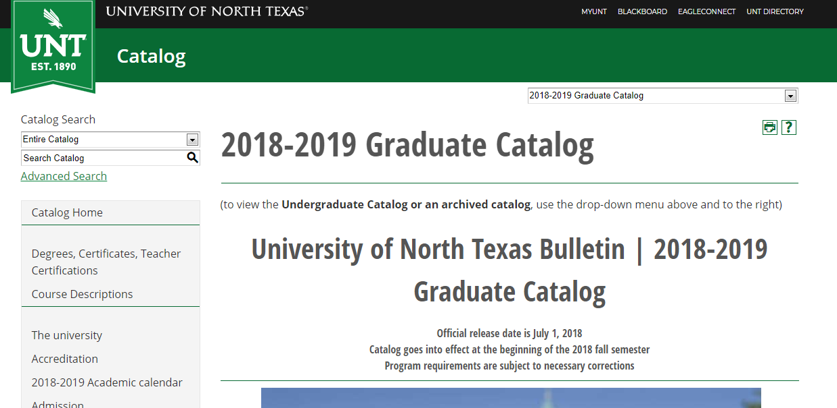
Important Resources
UNT Graduate Catalog

Slide 8
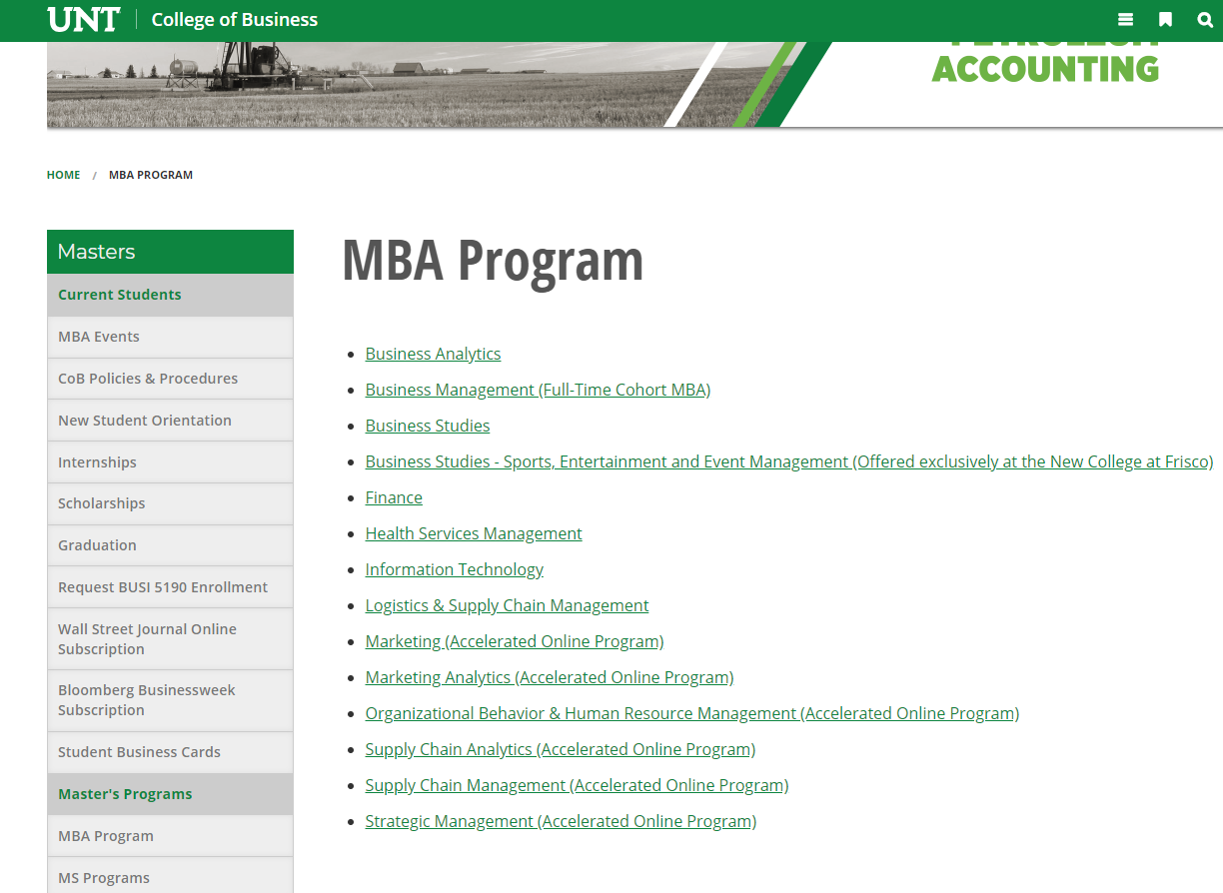
Important Resources
GPO Curriculum Guides

Slide 9
Your Degree MBA:
36 hours
18 hours of core
18 hours of concentration
MS:
30-36 hours
Discipline focused
On campus courses traditionally offered once a week in the evenings (Monday – Thursday)
Online options for all MBA core and some concentrations
MS programs on campus with less online options
If you have questions about class selections please feel free to see us after the presentation or set up an appointment with us the following week

Slide 10
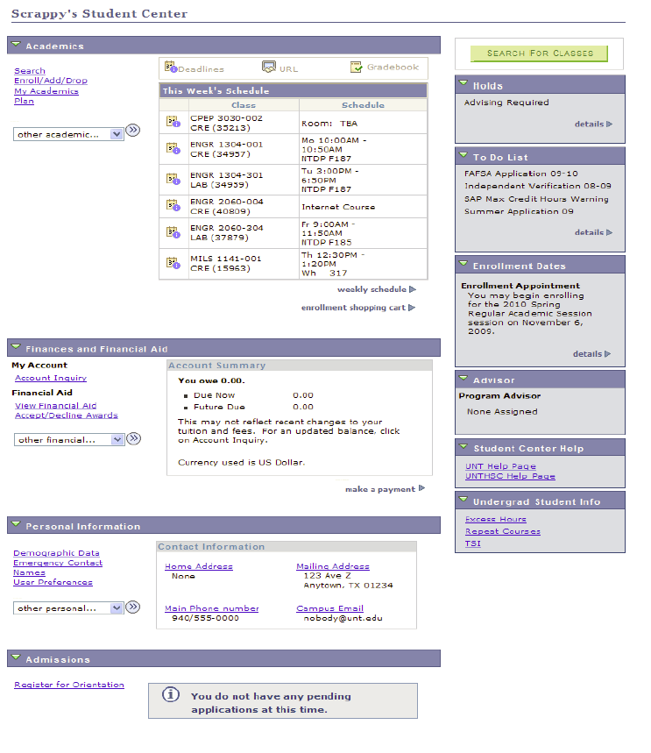
Registration & Payments
Be aware of Account Holds
Student Financial Obligation
Meningitis Education Notice
Check Enrollment Dates
New students register during regular registration unless otherwise notified
Register Early!
3. Enroll/Add/Drop
Search for courses
If courses are closed, GPO cannot sign students in over caps
Dropping all courses in a session or for the term requires intervention from the Registrar’s Office or Dean of Students
4. Pay your bill
Bills are not mailed
If Registrar payment deadline not met, courses will be dropped
ENROLL
HOLDS
ENROLL DATES
PAY

Slide 11


Background Courses
Fundamentals of Economics
Financial Accounting
Managerial Accounting
Business Statistics
Basic Information Systems
Corporate Finance
Principles of Marketing
Business Law
Quantitative Foundations
Please speak to the Graduate Programs Office if you have questions about background courses
$75 per module
$48 per module

Slide 12
Degree Plans and Advising
Your degree plan is required by the end of your first semester
To file, meet with your departmental advisor. Your advisor approves your degree plan and sends it to the Graduate Programs Office
Confer with your departmental advisor before enrolling in classes NOT listed on your degree plan
Let us know if you are not sure who your advisor is

Slide 13
Advising
Accounting: Christine Ellis
Christine.ellis@unt.edu
Finance: Lisa McDaniel
Lisa.mcdaniel@unt.edu or FIRELadv@unt.edu
Management: April Kuykendall
April.Kuykendall@unt.edu
Marketing & Logistics: Terrence Suber
Terrence.suber@unt.edu
Info Tech & Decision Sciences: Dr. Donna Lohr
Itdsadv@unt.edu
Marketing Analytics & Sport, Event, and Mgmt: DeAnna Taylor Deanna.taylor@unt.edu
Business Studies: Natalie Bernard
Natalie.bernard@unt.edu

Slide 14
DeAnna Taylor- Deanna.taylor@unt.edu
Natalie Bernard- Natalie.Bernard@unt.edu
GPO Counselors are always available to assist students
Especially with the following issues:
Background course completion and general prerequisite questions
Registration Issues
Academic procedures and policy
Academic success issues, i.e. probation, suspension, etc.

Slide 15
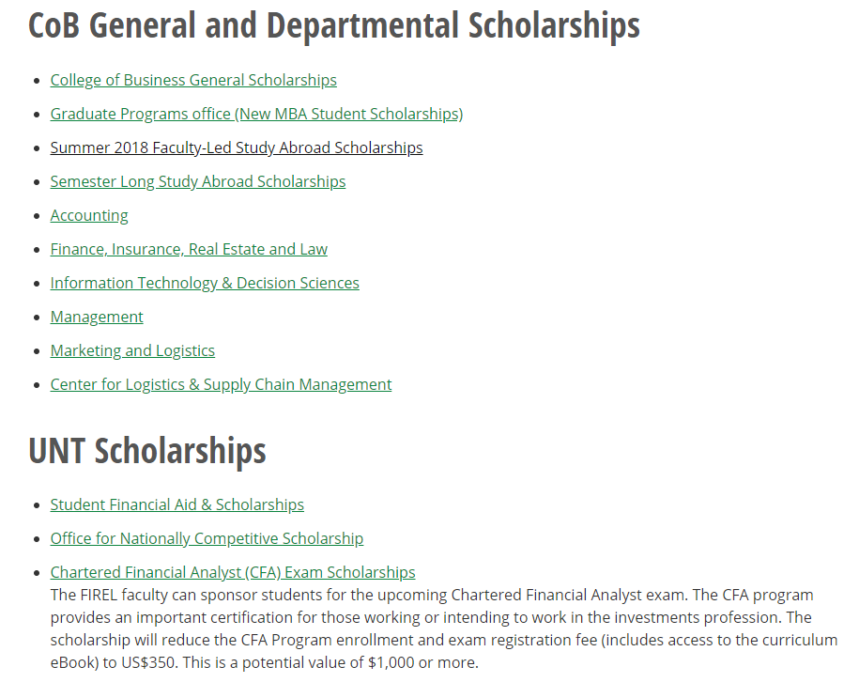
Scholarships and Awards
COB Scholarships

Slide 16
Probation Policy
Students are required to maintain a 3.0 graduate GPA to be in good standing
Students will be placed on probation if the GPA falls below 3.0
Students will remain on probation and be allowed to continue taking courses as long as they achieve a 3.0 GPA during a semester even if their cumulative GPA is still below 3.0

Slide 17
Suspension Policy
Students already on probation will be placed on academic suspension for one semester if the GPA in a successive semester falls below 3.0
A second suspension will result in dismissal from the College of Business
Students may reapply after three years

Slide 18
Retention Policy
Students may not graduate with more than two C’s in their core and/or concentration courses, or any grades of ‘D’ or ‘F’
If three C’s have been earned, at least one course must be duplicated with a grade of B or better. Any grades of ‘D’ or ‘F’ must be repeated
If duplications are required (for any grade, “C”, “D” or “F”) it will be necessary to consult with your academic advisor immediately
If a student receives two course grades below ‘C’ (for purposes of this rule, the lowest grade received in a course is always used, regardless of duplication), the student will be dismissed from the program

Slide 19
Dropping Courses & Duplications
Needing to drop a course?
There will be an online form available
Students will not need permission from a professor or a signature from the department
Need to duplicate a course?
Students get two duplications at the masters
You cannot duplicate the same course twice

Slide 20
Graduation
ALL STUDENTS MUST FILE FOR GRADUATION
Must have a 3.0 cumulative GPA
Must not have any grades of ‘D’ or ‘F’
Must not have more than two grades of ‘C’
Graduation applications are due during the first few weeks of the semester in which you graduate
Visit your MyUNT to apply for Graduation
For more information about commencement events, please visit commencement.unt.edu or tgs.unt.edu

Slide 21
Campus Resources
Career Center
Financial Aid & Scholarships
Graduate Programs Office
Internship Office
Registrar’s Office
Toulouse Graduate School
Dean of Students
UNT Writing Lab
UNT Learning Center
UNT Math Lab
College of Business Labs:
Accounting Tutoring Lab
Finance Tutoring Lab
ITDS Tutoring Lab
Computer Lab
Virtual Computer Lab
Money Management
Graduate Student Council
Office of Disability Accommodations
Student Veteran Services Office
Off Campus Student Services
Counseling and Testing Center

Slide 22
Best of Luck and Congratulations!
Graduate Programs Office
BLB Suite 201
940.369.8977
MBACob@unt.edu
www.cob.unt.edu/programs/masters

Slide 23

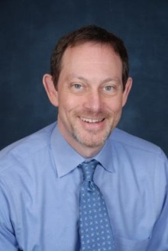
university of north texas
career center
Dr. Brian Hirsch
Assistant Director
Career Center – BLB 136
Brian.Hirsch@unt.edu or 940-369-7238

Slide 24
MBP (My Business Plan)
Create Your Vision
Strategic Occupational Goals
Your Mission Statement (aka elevator speech)
Tell Your Story
Your Personal Value Proposition
Your Deliverables
Take Action
Implement
Networking
Applications

Slide 25

Services

Slide 26
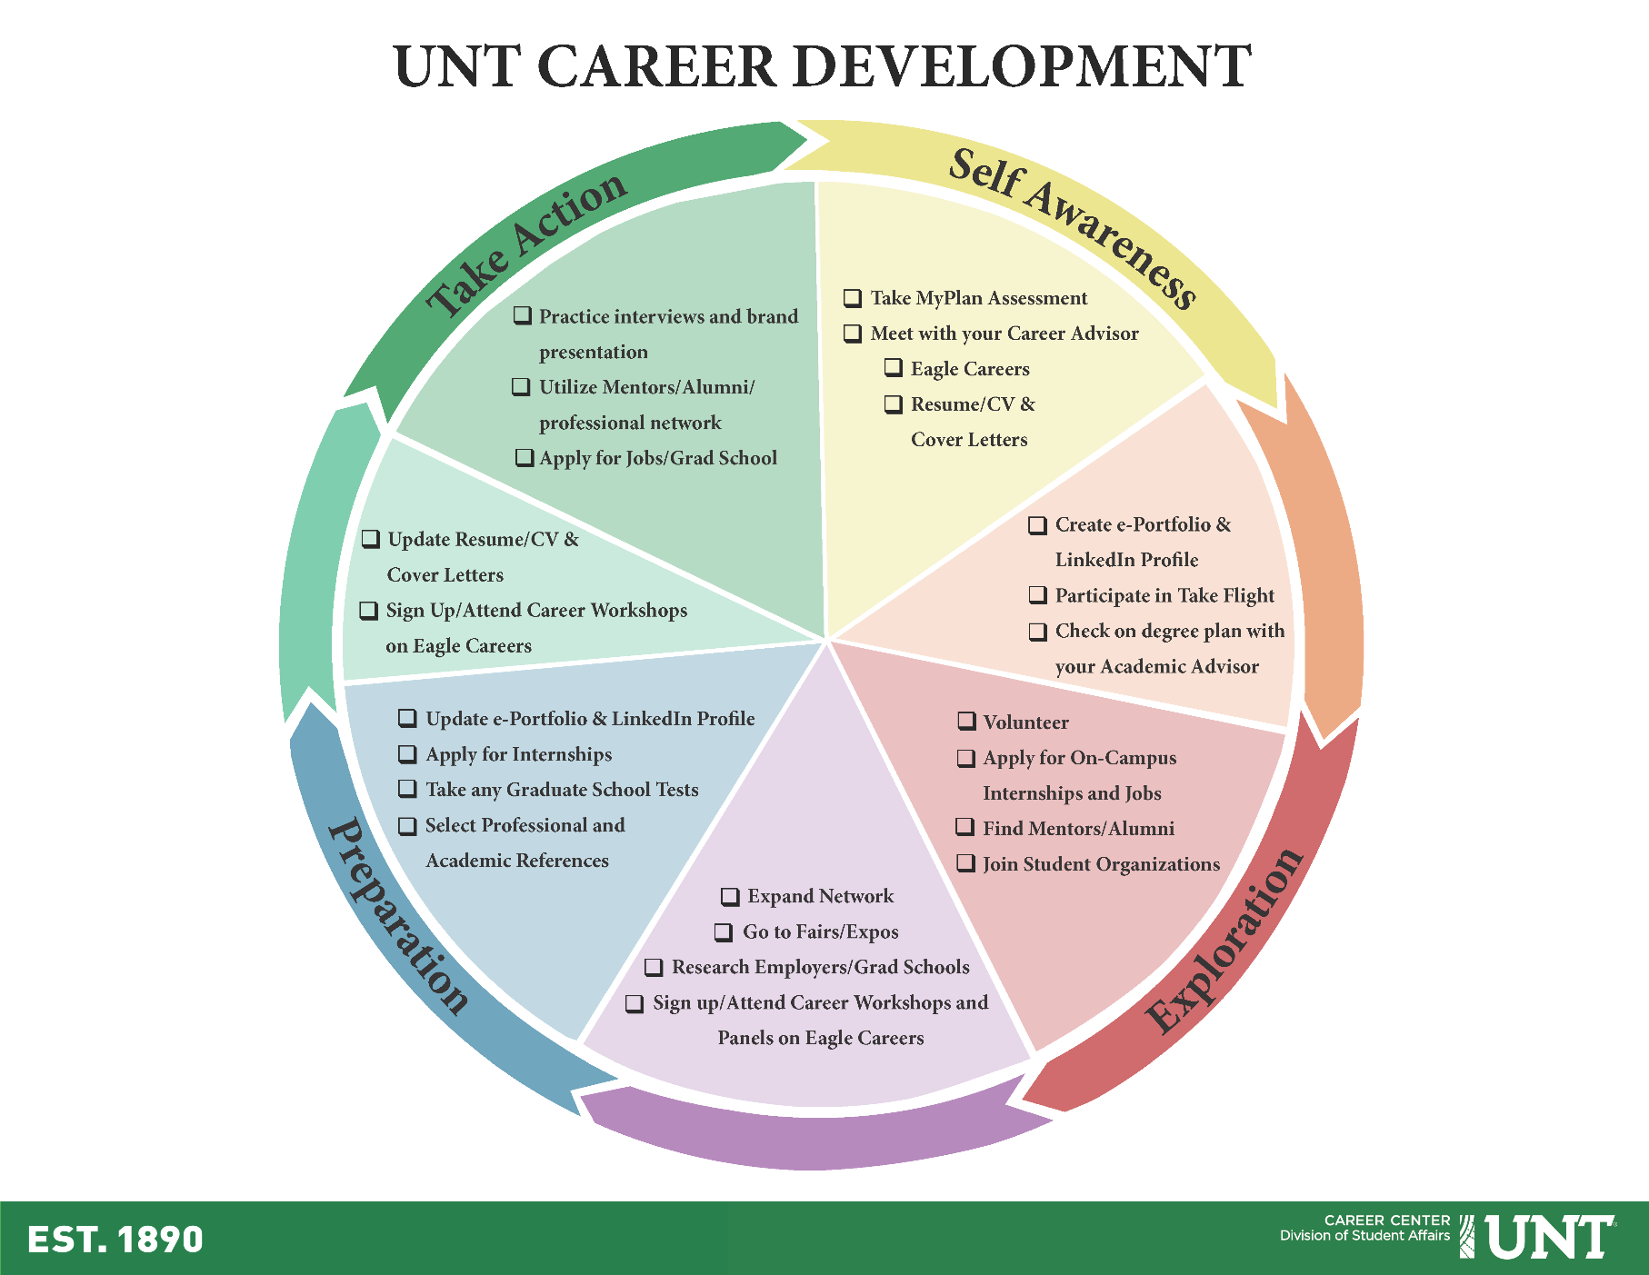

Slide 27


The New Eagle Careers powered by Handshake
Discover new career paths. Find amazing jobs and internships. Connect with great companies and non-profits.
Show off your best self to employers
Over 6,000,000 students from over 400 universities use Handshake
unt.joinhandshake.com

Slide 28

The New Eagle Careers powered by Handshake
Getting Started:
An email invitation from Handshake to your UNT email
Set up your profile
Set up your preferences
Upload your resume
WATCH Your Account for
Job and internship recommendations
Upcoming Events and Workshops
Upcoming On-campus Interviews
unt.joinhandshake.com

Slide 29

Career Connect
Get hands on experience, prove it, and get the job with Career Connect
Communication Skills
Critical Thinking
Teamwork
Set yourself apart with the Career Connect e-portfolio
Notes:
How I Got Started in Business c39f2d3
Students have the opportunity to add to their e-portfolio by reflecting on their experience in attending your session. The invite codes below will provide the students with access to your community as a Career Connect session. On the entry page in their e-portfolio, there is a section at the bottom called “communities.” If a student clicks on the “+” in that section, they will be able to enter the invite code and join the community. Once there, they will find instructions regarding how to reflect on their experience in your session.

Slide 30


Slide 31
sample companies hiring
real world partnerships
mba/ms students
BURLINGTON NORTHERN SANTA FE • CAPITAL ONE • CGI • CINTAS • CORBAN GROUP • DELL • DENTON COMMUNITY HOSPITAL • EDWARD JONES • EDS • EQUITRUST LIFE INSURANCE • EXPEDITORS INT. OF WA • FIDELITY INVESTMENTS • FIRST AMERICAN • FRITO-LAY • GEORGE GROUP CONSULTING • GOODYEAR TIRE • HERTZ CORPORATION • HERTZ EQUIPMENT RENTAL • IBM • INTERSTATE BATTERIES • KROGER • L-3 COMMUNICATIONS • LIBERTY MUTUAL • LABATT FOOD SERVICE • MED SYNERGIES • METL-SPAN • MRCS, INC. • NCH CORPORATION • NEW YORK LIFE • NOKIA • ORTHOFIX INC. • PETERBILT • PROTIVITI • QUIK-TO-FIX FOODS • SABRE HOLDINGS • SOUTHWEST AIRLINES • JP MORGAN • SPECIALITY PRINTING • EDS • SPECTRUM FINANCIAL GROUP • STATE FARM INSURANCE • DELL • TARGET CORPORATION • TEXAS INSTRUMENTS • TRANSFORMATION • VERIZON INFORMATION SERVICES • VOUGTH AIRCRAFT IND., INC. • CGI • WELLS FARGO • ACKLEY FINANCIAL GROUP • ADVANCE MICROBIAL SOLUTIONS • IBM ALCATEL • AMERICREDIT • ASI BUSINESS SOLUTIONS • ATC LOGISTICS •EDS

Slide 32

CAREER
Contact for Appointment:
brian.hirsch@unt.edu
(940) 565-2105 – BLB 136
Phone appointments available
Skype appointments available

